Slide 1



TECHNICAL PRESENTATION
A COMPARATIVE ANALYSIS OF CAESAR AND VIGENÈRE CIPHERS
CSA5112 – CRYPPTOGRAPHY AND NETWORK SECURITY
UNDER THE GUIDANCE OF :
DR.C.SIVASANKAR
PRESENTED BY:
M.RAMPRASADH(192511355)

Slide 2
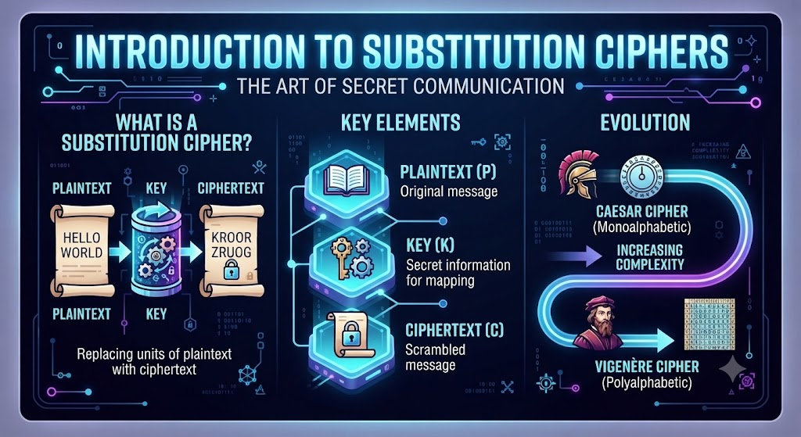
INTRODUCTION
A substitution cipher is an encryption technique in which each plaintext letter is replaced with another letter according to a rule or key.
Plaintext: The original readable message.
Ciphertext: The encrypted, unreadable message.
Key: The value or keyword used to encrypt and decrypt the message.
Caesar cipher uses a fixed letter shift, whereas Vigenère cipher uses a repeating keyword to change the shifts.

Slide 3

CAESAR CIPHER
Caesar cipher replaces each plaintext letter with another letter shifted by a fixed number of positions.
A numerical key determines the shift.
With key 3, each letter shifts three positions forward.
Encryption: \(C=(P+K)\bmod 26\)
Decryption: \(P=(C-K+26)\bmod 26\)
Encryption produces ciphertext; decryption recovers plaintext.
Example: HELLO → KHOOR (Key = 3)
Used in educational puzzles to demonstrate basic encryption and decryption.

Slide 4
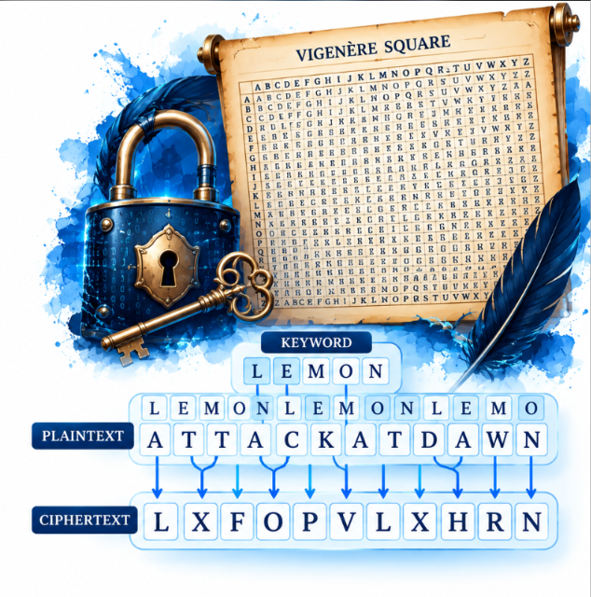
VIGENÈRE CIPHER
Vigenère cipher is a substitution technique that uses a keyword to encrypt a message.
The keyword repeats to match the length of the plaintext.
Each letter is shifted according to the corresponding key letter.
Encryption: \(C=(P+K)\bmod 26\)
Decryption: \(P=(C-K+26)\bmod 26\)
It uses multiple shifts, making it stronger than a Caesar cipher against simple attacks
Used in cryptography challenges to demonstrate keyword-based encryption

Slide 5
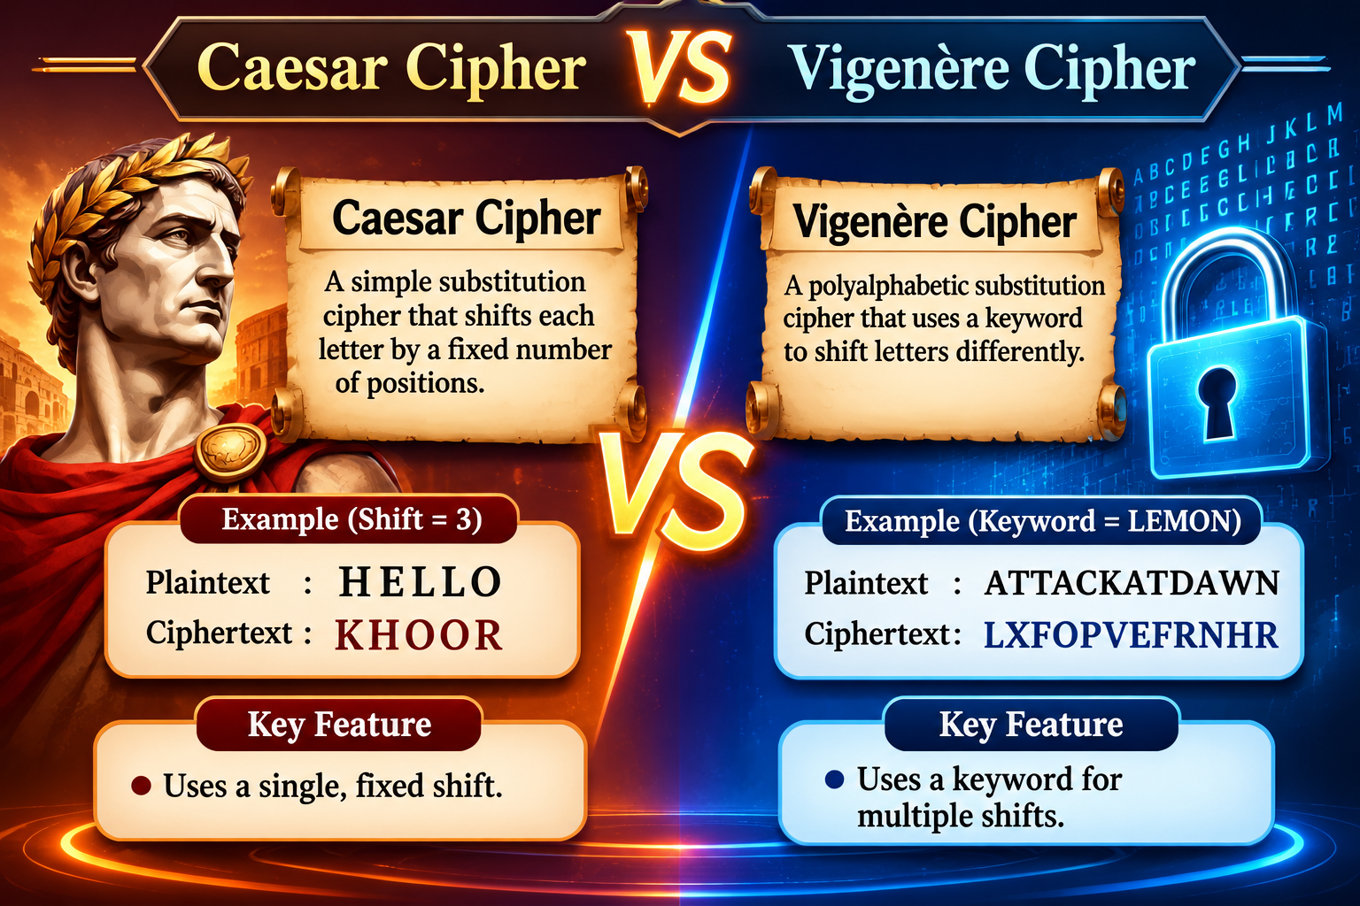
CAESAR CIPHER VS VIGENÈRE CIPHER
Caesar cipher uses a fixed shift, while Vigenère uses multiple shifts.
Caesar uses a numerical key, whereas Vigenère uses a keyword.
Caesar is simple to implement, while Vigenère is more complex.
Caesar is vulnerable to brute-force attacks; Vigenère resists simple frequency analysis more effectively.
Vigenère offers better historical security, but both are unsuitable for modern data protection.

Slide 6

CONCLUSION
Caesar and Vigenère are classical substitution ciphers used to understand encryption.
Caesar cipher is easily broken because of its limited key possibilities.
Vigenère improves security by using multiple letter shifts.
Repeated keywords can make Vigenère vulnerable to cryptanalysis.
Modern encryption algorithms provide stronger protection for sensitive data.

Slide 7



